Slide 1
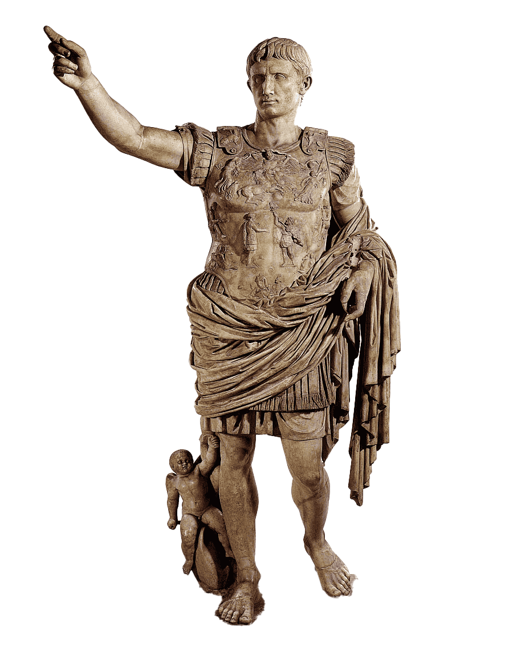
Monument 3: The Augustus of Prima Porta
The Augustus of Prima Porta (about 15 AD?)
Found at Livia’s extraurban villa called Prima Porta (click) north of Rome
Artistic value
Modeled upon Polycleitus’ Doryphorus (its stance)
Idealized (classicized) reality
Recognizable as Augustus
Low-slung toga-drape recalls Venus Genetrix images (& clothes nakedness)
Texturization of stone is variegated to suggest different materials
Propagandistic value
Diplomatic victory over Parthians shows the regime’s political sway.
Cupid holding the “coat tails” connects Augustus to his divine legacy
The dolphin might recall victory at Actium
Barefoot emperor may already be divinized here — eternally young

Slide 2
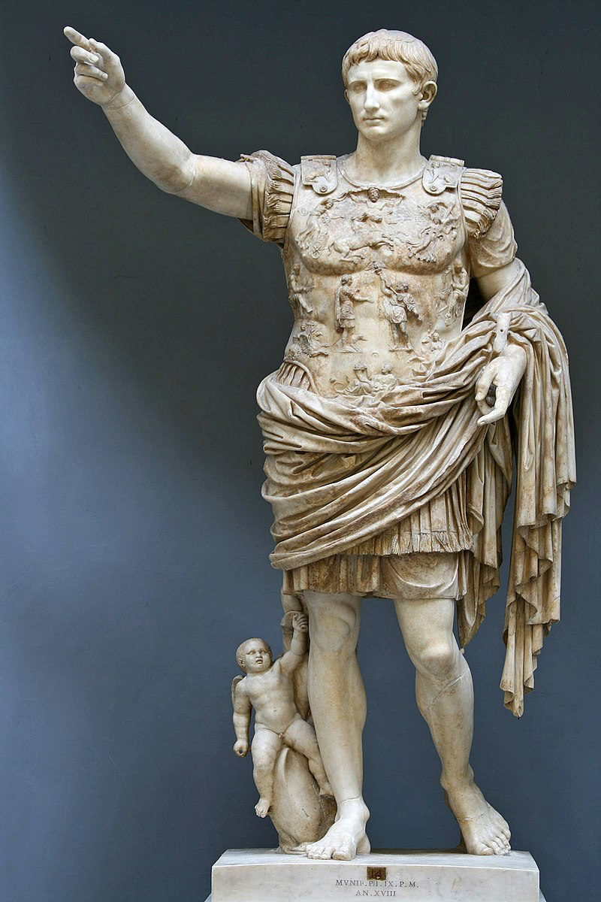
Augustus of Prima Porta — overview
a marble statue of Augustus, likely a posthumous copy of an earlier (bronze?) original representation of official portraiture
Named after Livia’s suburban villa where she dwelt after Augustus’ death in 14 AD [Google Earth]
Promotes reverence for the classical past (as is manifest in much of the Augustan cultural programme)
Depicts the recovery of the military standards lost at Carrhae (to the Parthians) in 53 and recovered in 19

Slide 3
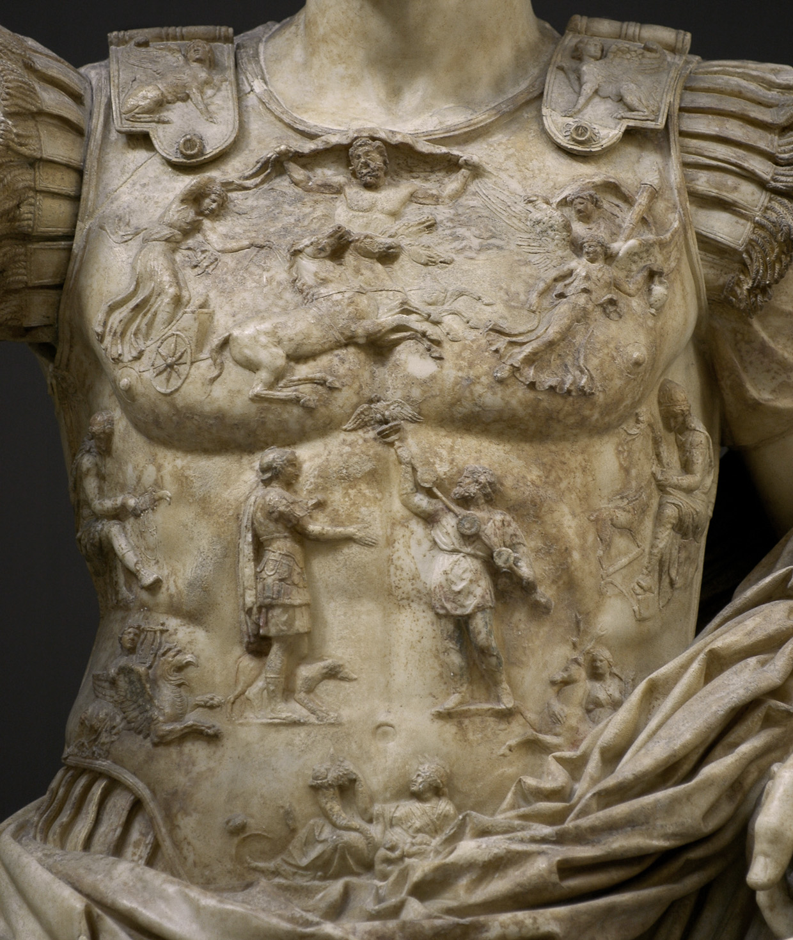
Recovery of the standards from the Parthians
The cuirass or lorica is stylized
The cuirass or lorica is stylized
Sky personified holding vault of heaven
Helios/Sol rides quadriga
Eos/Aurora opposite
Tellus (Earth) w/ cornucopia
Apollo on griffin
Diana on stag
Subjugated provinces
A Roman and a Parthian
Augustus? Tiberius? Romulus? Quirinus?

Slide 4
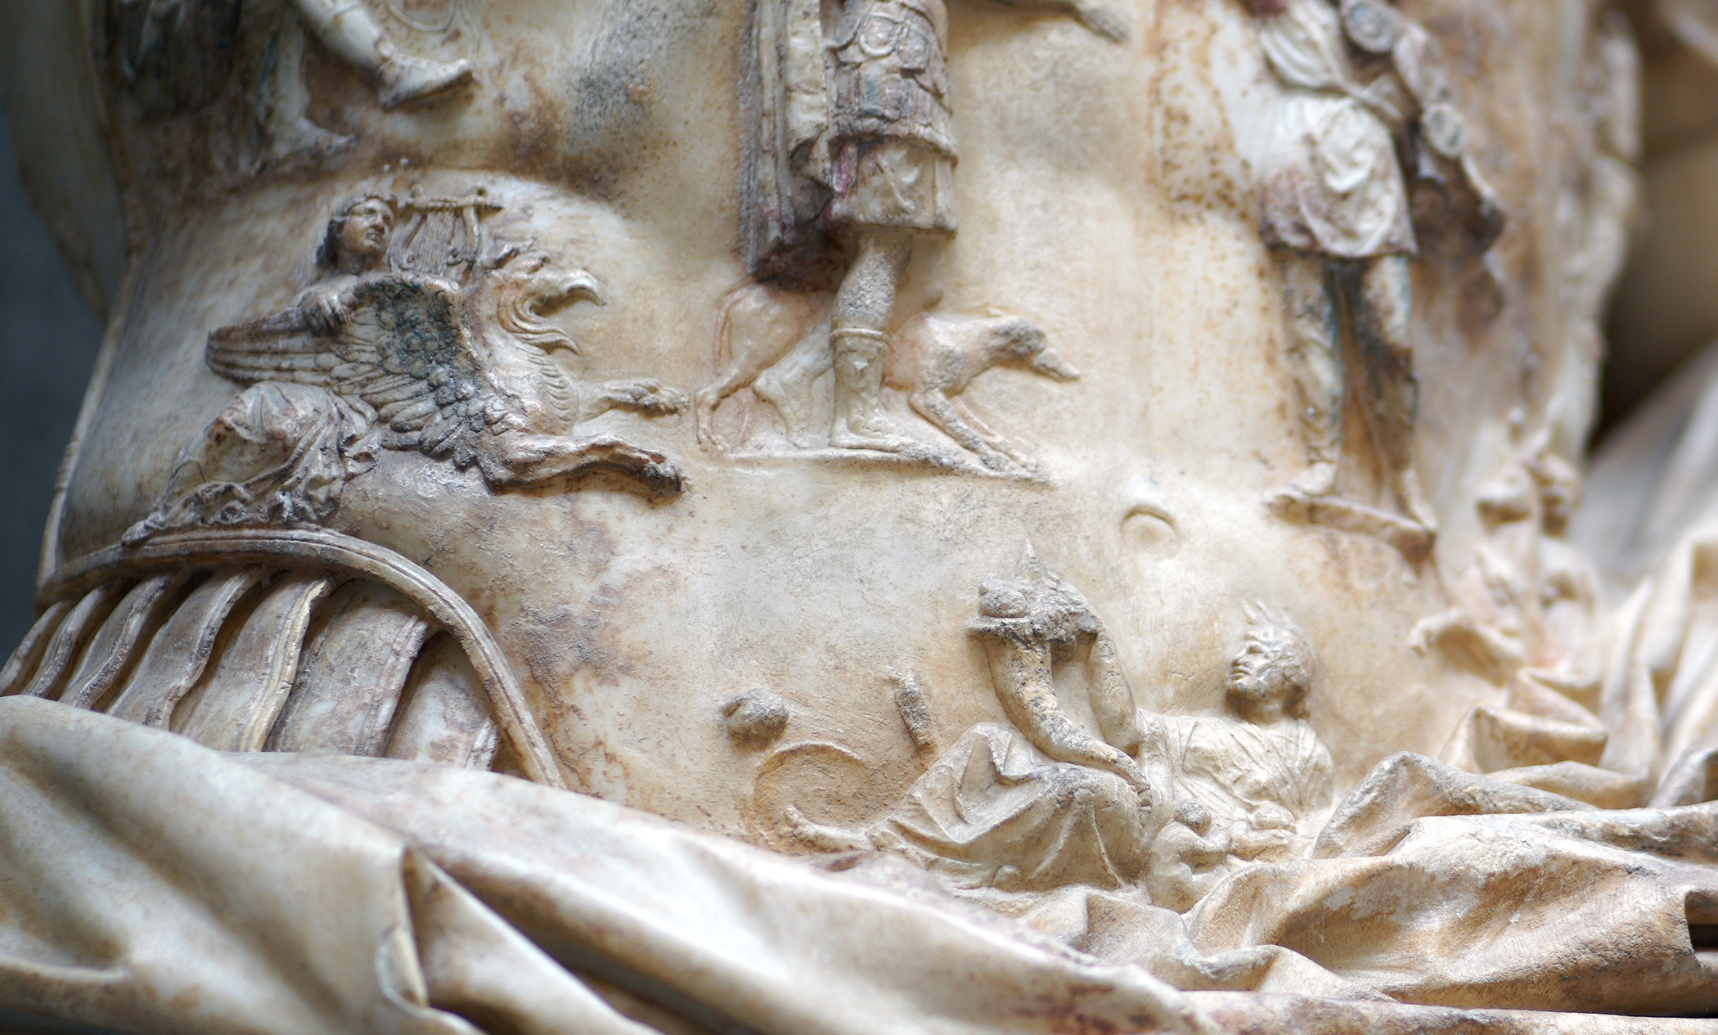
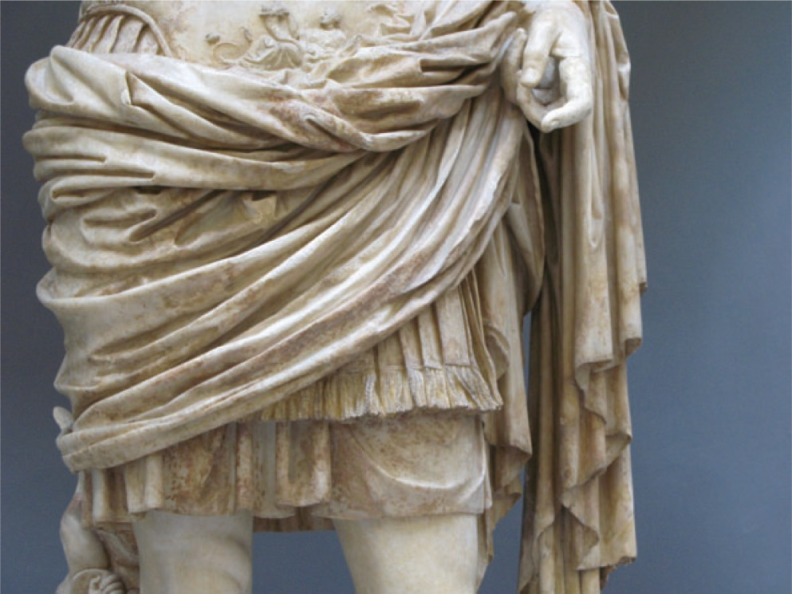
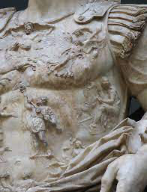
Recovery of the standards from the Parthians
The cuirass or lorica is stylized
Sky personified holding vault of heaven
Helios/Sol rides quadriga
Eos/Aurora opposite
Tellus (Earth) w/ cornucopia
Apollo on griffin
Diana on stag
Subjugated provinces
A Roman and a Parthian
Augustus? Tiberius? Romulus? Quirinus?

Slide 5
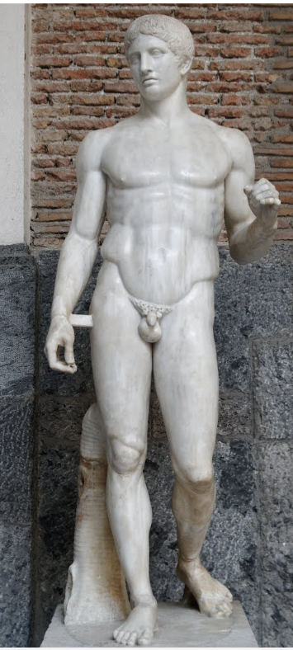
Doryphoros of Polykleitos — reverence for the Classical past
Polykleitos was a master of contrapposto composition
Prima Porta:
The gesture of adlocutio “updates” the sculpture’s purpose
The cupid riding the dolphin reminds, perhaps, of Augustus’ Julian descent from Venus. And perhaps a recollection of the naval victory at Actium.
Bare feet likely suggest divinization. Whether the original was shod is debated.

Slide 6

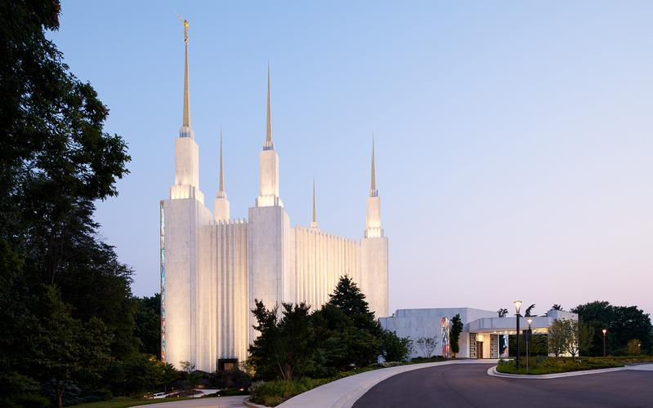
Doryphoros of Polykleitos — reverence for the Classical past
Harold K. Beecher, architect
dedicated November 1974
Truman O. Angell (1810-1887) dedicated April 1893
Polykleitos was a master of contrapposto composition
The gesture of adlocutio “updates” the sculpture’s purpose
The cupid riding the dolphin reminds, perhaps, of Augustu’s Julian descent from Venus. And perhaps a recollection of the naval victory at Actium.

